Slide 1
Widget Development
Focus Area: Front-end
Notes:
Pre requisites:
Node and NPM already installed.
CXP Manager already installed (RWC 2.3) https://my.backbase.com/docs/how-to-guides/article//setting-up-cxp-5-6-x-and-widget-collection-2-1-x-from-scratch

Slide 2
Training Overview
Group Workshop
Back-end
Front-end
Services
Integration
Content
Services
Advanced
Security
Widget
Development
Widget Extras
Targeting
Publishing
Container
Development
Foundation
Portal Essentials
Portal Technologies
Portal Tools
Portal APIs

Slide 3
Agenda
Understanding Widgets
Widget Collection 2.X
BB-CLI
Setup Portal Theme
How to develop widgets
Notes:
Concepts and Architecture
Latest WC
Make Development Easier
How to work with styles across your portal
Understand How To Develop widgets
At the end of this module, the trainee should be able to understand what a widget is, and be able to develop his own widget, add functionality, style it, import and use it in the portal manager.
https://www.npmjs.com/org/backbase
BB-CLI tools:
npm install --global @bb-cli/bb-package @bb-cli/bb-import @bb-cli/bb-generate
BB-generate Generators:
npm install --global @backbase/generator-project-statics @backbase/generator-model-ng @backbase/generator-widget @backbase/generator-ui-ng @backbase/generator-ext-ng
In order to follow the various exercises in this training, you will need to refer to the training material available here:
https://bitbucket.org/backbase/training-cxp-fe

Slide 4
Understanding Widgets
Widgets Overview
Notes:
Before developing a widget, trainees need to understand what a widget is. For people that haven’t worked with BB portal before, there might be confusion with things like jquery widgets etc.

Slide 5
What is a widget?
“Widgets are autonomous mini-applications, designed to run within a web page. They implement reusable pieces of business logic, with which you can compose your web application.”
Notes:
Key points:
Mini-applications: they contain logic and perform operations, which is different from a ui widget like those defined in jquery ui, or in bootstrap
Autonomous: they should work, by themselves in any page that you use them, without depending on other widgets to function properly. This doesn’t mean that they need to contain all the libraries used. They can depend on js libraries that exist in the global project scope
Reusable: A widget is meant to be used multiple times, in different portals, in the same portal, and some times even in the same page. We need to keep this in mind while developing
Business Logic: Widgets should contain business logic and minimal styling.

Slide 6
Why Backbase Widgets?
Reusability
Maintainability
Development
Stack
Encapsulation
Notes:
Maintain: Easier to debug
Encapsulation: Drag and Drop
Development Stack: It’s great to work with the latest technologies, so we are providing them to you
The audience at this point are developers. They need to understand the advantages to them:
You create things that the business can re-use in different places, removing the need to code the same thing again and again.
Easier to debug, because you are debugging in a smaller scope
Logic is contained (mostly) within the widgets and not spread out within the application. Of course there are exceptions. Simply put: if you have a payment widget, you know that you will find most of the logic about making payments in there
Skillset:
HTML5 / XHTML
JavaScript (UMD, jQuery, Angular.js)
CSS
UMD - Asynchronous Module Definition - http://requirejs.org/docs/whyamd.html
nice to have:
Twitter bootstrap
Mustache
LESS.css

Slide 7

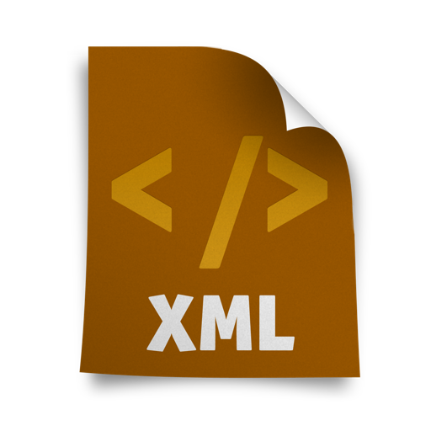
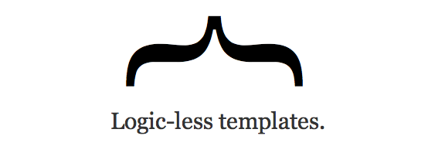






Development Stack
Development Stack
Notes:
The audience at this point are developers. They need to understand the advantages to them:
You create thingre-use in different places, removing the need to code the same thing again and again.
Easier to debug, because you are debugging in a smaller scope
Logic is contained (mostly) within the widgets and not spread s that the business can out within the application. Of course there are exceptions. Simply put: if you have a payment widget, you know that you will find most of the logic about making payments in there
Skillset:
HTML5 / XHTML
JavaScript (UMD, jQuery, Angular.js)
CSS
UMD - Asynchronous Module Definition - http://requirejs.org/docs/whyamd.html
nice to have:
Twitter bootstrap
Mustache
LESS.css

Slide 8
Widget Anatomy
Widget Development

Slide 9
Widget Anatomy
Model
Page Instance
Widget Instance
<<extends>>
Portal Catalog
Widget Portal
Catalog Item
<<extends>>
Server Catalog
Widget Server
Catalog Item
Standard_Template
TemplateName
src
widgetChrome
Web Tablet Smartphone
Resources
Widget Definition
(index.html)
Widget Chrome
standard_template
Javascript
CSS
Notes:
WHERE DID WIDGETS IMPORT?
QUESTIONS?
Widget architecture is separated in two parts:
The model
You first get a server catalog item, referencing a widget template
Enabling it for a portal creates a portal catalog item
Dropping a widget on a page creates a widget instance
The resources
A physical template file, related to the template the widget is using
A widget definition (aka, the html)
A widget chrome (default or custom)

Slide 10
Widget Definition
HTML5
Document
XML Compliant
g:namespace
Notes:
A widget is:
An HTML5 document
Needs to be XML compliant (for the XML parser in CXP…) – WELL FORMED CODE
The “g:namespace” provides us with extra HTML tags enabling things like server-side rendering

Slide 11
Widget Definition
<!DOCTYPE html>
<html xmlns=http://www.w3.org/1999/xhtml
xmlns:g="http://www.backbase.com/2008/gadget" xml:lang="en">
<head>
<meta http-equiv="Content-Type" content="text/xml; charset=UTF-8" />
<link rel="stylesheet" href="styles/base.css" type="text/css" />
<script src=“scripts/index.js"></script>
</head>
<body>
<h1>Widget Title</h1>
</body>
</html>
Notes:
HTML 5
G:Namespace
Head section: Include JavaScript / CSS
Body: Markup

Slide 12
Resource Aggregation Basic
Bank Portal
<head>
<title>Bank Portal</title>
<link href=“account-balance.css”/>
<script src=“jquery.js”></script>
<script src=“stock-ticker.js”></script>
<script src=“account-balance.js”></script>
</head>
<body>
</body>
My Stocks Widget
<head>
<script src=“jquery.js”></script>
<script src=“stock-ticker.js”><script>
</head>
<body>
</body>
Account Balance Widget
<head>
<link href=“account-balance.css”/>
<script src=“jquery.js”></script>
<script src=“account-balance.js”><script>
</head>
<body>
</body>
12
Notes:
JS dependencies: server-side aggregation based on file name.

Slide 13
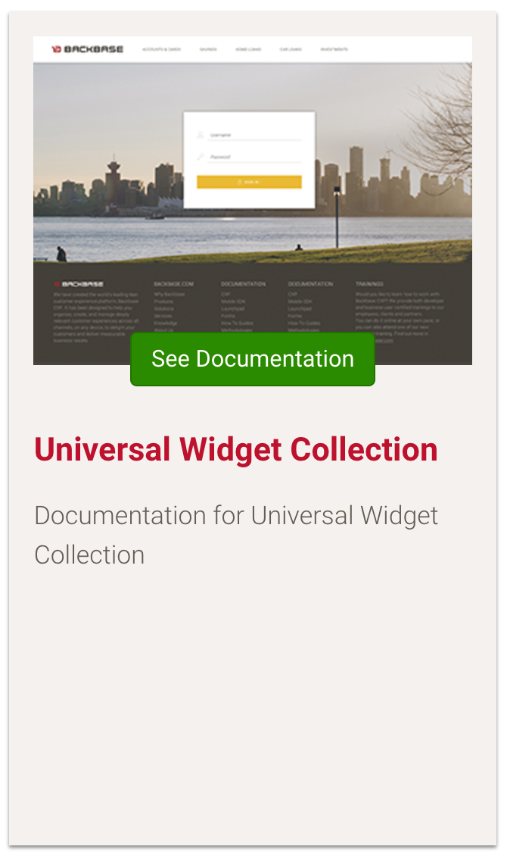
Universal Widget Collection
Universal Widget Collection
Content Widget
Structured Content Widget
Breadcrumb Container
Login Widget
Navigation Widget
Columns Container
Notes:
Explain that the Universal Widget collection contains the legacy widgets. Is also important to explain that if you want to modify these widgets they are based on the old architecture.
Not Angular Based
Common Functions for Portals
Documentation
https://my.backbase.com/docs/product-documentation/documentation//portal/5.6.3/portalservices_universal.html

Slide 14
Widget Collection 2.X
Widget Development - Understanding Widgets

Slide 15
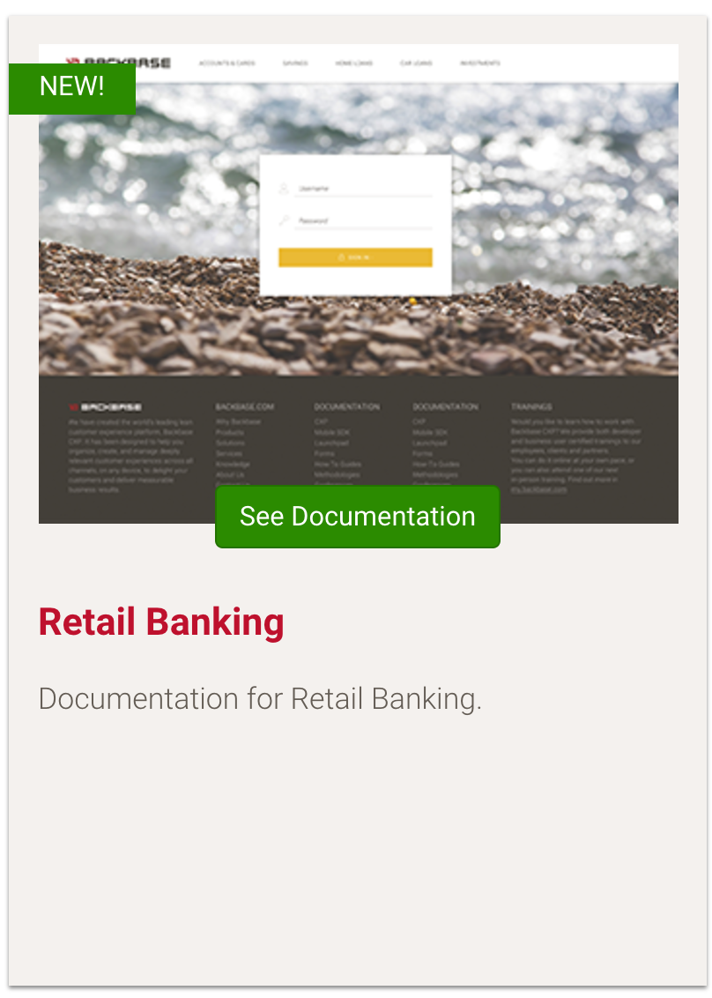
Widget Collection
Widget Collection Retail Banking 2.X
Out-the-box Functionality
Login, Transactions List, Product Summary and many more…
Extendable & Upgradable
Frontend Building Blocks
Notes:
Explain that Retail Widget Collection without FBB can’t exist and show the documentation about the widgets that are available in RWC2.
API:
http://docs.backbase.com/extranet/technical-docs/collection-retail/2.3.0/index.html
Documentation
https://my.backbase.com/docs/product-documentation/documentation//Retail-Banking/2.3.0/index.html

Slide 16
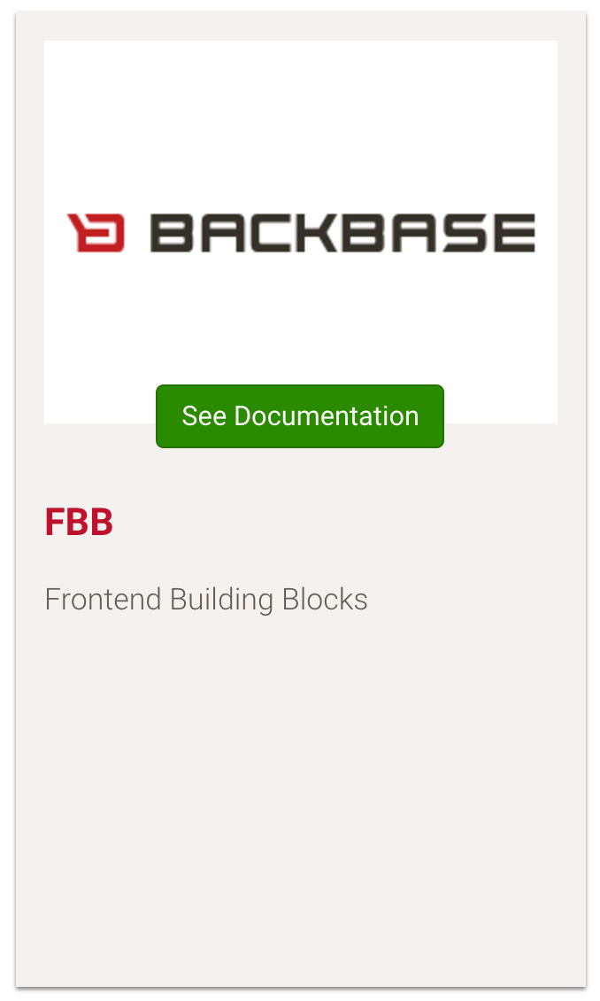
Frontend Building Blocks (FBB)
Frontend Building Blocks
Set of elements or components
Basic Libraries
Configuration
Events
i18n
Error Handling
Storage
Default Theme
Mobile Plugins Connector
Vendor Libraries
UI Components
Notes:
Explain that FBB is like a set of Lego Blocks that you can use and reuse to create your own widgets.
Explain about how SystemJS can’t be configured and why and how it can be used. -> https://github.com/systemjs/systemjs
http://docs.backbase.com/extranet/technical-docs/fe-building-blocks/2.1.2/index.html

Slide 17
Demo: Widget Collection Documentation
Let’s take a look at the documentation of Widget Collection to see what it offers
Notes:
GOING TO COME BACK TO THIS DURING EXTENSIONS
KEY
Show where to find the documentation and point out what to look for Docs > Collections
HOW
Show that there are How To Guides on how to set up
List in the current collection and show how it is documented
Show reference where there is API documentation (Also Front-end building blocks) and all the How To for developers
TIME
15 mins

Slide 18

Widget Application Detailed Overview
UI Component
UI Component
Extension
UI Component
Widget
Integration Services
Data-http RAML
Data-http RAML
Model
Data-http RAML
Portal Item Type
Widget
Feature
Notes:
Model Provides Data
The Data is delivered by providers, which are set up by RAML files
Integration Services are safe endpoints

Slide 19
Widget Definition
<!DOCTYPE html>
<html xmlns=http://www.w3.org/1999/xhtml
xmlns:g="http://www.backbase.com/2008/gadget" xml:lang="en">
<head>
<meta charset="utf-8" />
<title>Transaction List</title>
<script src="(…)/scripts/vendor-bb-systemjs.js"></script>
<script src="(…)/scripts/config-bb-module-loader.js "></script>
<script src="(…)/scripts/lib-bb-start.js"></script>
</head>
<body g:onload="BB.Widget.ngStart(__WIDGET__);">
<div ng-cloak="ng-cloak" class="widget-bb-transaction-list-ng">
<g:include src="$(contextRoot)/(…)/${extension}/templates/template.ng.html" local="true">
</g:include>
</div>
</body>
</html>
Notes:
This is the Widget Definition that is being scaffolded in WC2.0 and it should not be modified.
Set of JS files being included that are always needed (angular is being included underneath it)
g:onload. Will execute the method onLoad, in this case the method is being passed the Widget Object __WIDGET__. Which is the instantiated widget model with their properties (also personalized properties) This in order for easy access to properties in Angular code
g:include. Based on the property, the angular template will be included. Which means you can switch extension (view) through property configuration

Slide 20
Resource Aggregation
Bank Portal
<head>
<title>Bank Portal</title>
</head>
<body>
</body>
<script src=“vendor-bb-systemjs/scripts/vendor-bb-systemjs.js”/>
<script src=“config-bb-module-loader/scripts/config-bb-module-loader.js”></script>
<script src=“lib-bb-start/scripts/lib-bb-start.js”></script>
My Stocks Widget
<head>
</head>
<body>
</body>
<script src=“vendor-bb-systemjs/scripts/vendor-bb-systemjs.js”></script>
<script src=“config-bb-module-loader/scripts/config-bb-module-loader.js”><script>
<script src=“lib-bb-start/scripts/lib-bb-start.js”><script>
Account Balance Widget
<head>
</head>
<body>
</body>
<script src=“vendor-bb-systemjs/scripts/vendor-bb-systemjs.js”></script>
<script src=“config-bb-module-loader/scripts/config-bb-module-loader.js”><script>
<script src=“lib-bb-start/scripts/lib-bb-start.js”><script>
Notes:
This architecture

Slide 21
g:include
Browser
Portal Server
Extensions
Transactions List Extension View
Widget
g:include
Transactions Chart Extension View
Notes:
Browser makes a request for a page at portal server
The page contains a widget that has a g:include tag
On rendering the widget, the g:include triggers the Portal Server to fetch the data from the configured path
On receiving the data, it simply replace the payload with the g:include element
The fully rendered page will be send to the browser to be displayed
As you can imagine, the g:include tag does not have any error handling or has any control on transforming the data
Therefore, it better solution would not to directly point it to the remote server, but to point internally to the integration service. Where the backend can handle error handling and any transformation etc.

Slide 22
BB-CLI
Widget Development

Slide 23

BB-CLI
What is BB-CLI?
bb-cli is a command line tool provided and supported by
To ease front-end development for Backbase Platform.
BB-CLI commands
bb-generate
bb-package
bb-import
bb-config
bb-test
bb-serve
bb-customize
bb-convert
bb-bundle
and many more…
Notes:
Show the page in my.backbase.com to explain about bb-cli. -> https://docs.backbase.com/extranet/technical-docs/bb-cli/2.0/
If the user already has installed an old version of bb-cli tell him to remove it completely from its computer because both are not compatible each other.
If the user wants or needs to keep both, the user can download NVM and then install a new Node version where he will be available to install the new tool.
Remark that all the new tooling are replacements for the existing tools but that there is a set of tools that has been created to improve the productivity as for example the bb-package, bb-bundle, bb-serve and bb-convert.
Explain one by one what they do:
bb-generate => used to generate elements or components using a template (the generator)
bb-serve => used to develop standalone without needing to import the collection every time but there are a few things to be solved to be completely useful.
Issues:
The extension can’t be changed, and to see the widget with a different extension you have to import the widget and the extension to your portal and do it from there.
Working with the standalone version the pubsub is mocked and there is no information when one event is triggered or listened.
Benefits:
Very useful for mobile hybrid development with the mobile SDK.
bb-bundle => it’s one of the most powerful tools that can create a bundle for one specific page, container…
bb-package => used to package an element or the whole generating a zip-of-zips ready to be imported.
Theme requires to use a plugin to load SASS
Pages and page templates should be added in a prebuilt folder because they don’t need to be built.
bb-import => used to import the zip-of-zips to the Enterprise Catalog.
bb-convert => used to generate data-providers or mock data-providers from a RAML file. That makes consistent the relationship between backend and frontend.

Slide 24
Naming Convention
What is the naming convention?
{type}-{project}-{name}-{subname}-{meta}
type
project
name
subname
meta
Item type (widget, extension, model, data provider etc.)
Name of the project. For building blocks and released widgets it’s always bb
Name of the item which also acts as an identifier. Items with the same name will conflict with each other.
Additional name to further describe the item. Allows for more additional subnames
Meta information of the package, eg. ng for angular related packages
Notes:
Subname is optional.
Meta is optional but we really enforce the developer to set a meta.
For example for widgets that relay on Angular we use ng

Slide 25
Naming Convention
Naming Convention Examples
Item | Naming Convention | Example
Widget | widget-{project}-{name}-{subname}-ng | widget-bb-contact-ng
Extension | ext-{project}-{name}-{subname}-ng | ext-bb-contact-list-ng
Model | model-{project}-{name}-{subname}-ng | model-bb-contact-ng
Data Provider | data-{project}-{name}-{subname}-ng | data-bb-contact-http-ng
UI Component | ui-{project}-{name}-{subname}-ng | ui-bb-avatar-ng
Notes:
Subname is optional.
Meta is optional but we really enforce the developer to set a meta.
For example for widgets that relay on Angular we use ng
Remark that we’re usign subname within data-bb-contact-http-ng

Slide 26
Naming Convention
Follow the naming convention
Widget Architecture 2.X heavily relies on naming convention. Not following the naming conventions can lead to issues resolving dependencies.

Slide 27
Setup Portal Theme
Widget Development

Slide 28
Styling
Backbase
Themes
VS
Widget
Styles
Notes:
Before going into styling, you need to explain a couple of things:
Backbase Themes
What the server is, and how our themes are based on Bootstrap/LESS, but they can be built with any other preprocessor or plain CSS
2) What to put in theme, and what in the widget itself
Talk about OOCSS, reusable components.
As a rule of the thumb, any of the following is theme related:
typography (font styles on headings and paragraphs, related colors)
form elements (any styles on inputs, dropdowns, checkboxes etc)
links and buttons
navigation elements, breadcrumbs
grid system
specific helper classes (eg. clearfix, hidden etc)

Slide 29
Create your own theme
Setup the theme for the your portal
Create your own Theme through “bb-customize” based on the Retail Theme and name it “theme-training-default”
Create a Master Page and configure it to use your Training Theme
Notes:
This is the point where you must switch to the repository:
Repository URL: https://bitbucket.org/backbase/training-cxp-fe
In order to have access to the training repository use the following credentials:
User: training@backbase.com
Password: b4ckb4s3-tr41n1ng

